Slide 1
Title IX for Mandatory Reporters
Eulanda Cade, Title IX Coordinator & Taylor Sinclair, System Director for Title IX

Slide 2
Who, What, When and Why of Title IX
What is it?
Why Are We Talking About This Again?
When Have I Crossed the Line?
Why Should I Care?
WHAT CAN I DO?
Who Can Help?

Slide 3
What is Title IX?
A Federal Law
Prohibits Sex Discrimination
Eliminates Barriers to Educational Opportunities
Caused by Sex Discrimination

Slide 4
How is Sexual Harassment a Barrier to Educational Opportunities?

Slide 5
What is Sexual Harassment?

Slide 6
Quid Pro Quo

Slide 7
Severe, Pervasive Unwelcome Conduct

Slide 8
Sexual Assault

Slide 9
Dating Violence

Slide 10
Domestic Violence

Slide 11
Stalking

Slide 12
https://www.youtube.com/watch?v=pZwvrxVavnQ

Slide 13
I’m a mandatory reporter – What’s my role?

Slide 14
YOUR Responsibilities
Listen
Support
Make the Report

Slide 15
Listen
Listen to the individual and to their information
Refrain from…
Making decisions for the individual
Defining or labeling what happened
Blaming the individual for what has happened to them

Slide 16
Tips for Responding
Listen without judging
Remember you are not their therapist
Connect the individual with resources
Don’t promise an outcome
Remember, this is their experience, not yours
Don’t engage in victim-blaming
Clearly state “I am required to share this information with the Title IX Coordinator”

Slide 17
Check Your Assumptions at the Door
The story makes no sense
I know this person, he/she is no rapist
I could tell they were making up the whole story just by the way they were acting
You are a guy so you can’t be assaulted

Slide 18
Make the Report
Call or email the Title IX Coordinator as soon as possible, but no later than 24 hours after you receive the information
No Exceptions!

Slide 19
You Should Not…
Determine truth or accuracy of situation
Probe for details
Ask follow-up questions
Conduct an investigation
Determine fault

Slide 20
PSC’s Title IX Coordinator
Ms. Eulanda Cade
Title IX Coordinator
Office: Administration Building, Room 312
Phone:(402) 872-2230
Email: ECade@peru.edu

Slide 21
Mandatory Reporter or Confidential Resource? What is the Difference?
Mandatory Reporter
Confidential Resource
President
Vice Presidents
Deans
Title IX Coordinator
Housing/Residence Life Staff
Coaches and Assistant Coaches
Campus Security Officers
*Report information will be communicated to the Title IX Coordinator
Licensed Student Counselors
Athletic Trainers
*Can keep information they receive confidential and are not required to report information to the Title IX Coordinator (in most cases).
Faculty is in neither category!

Slide 22
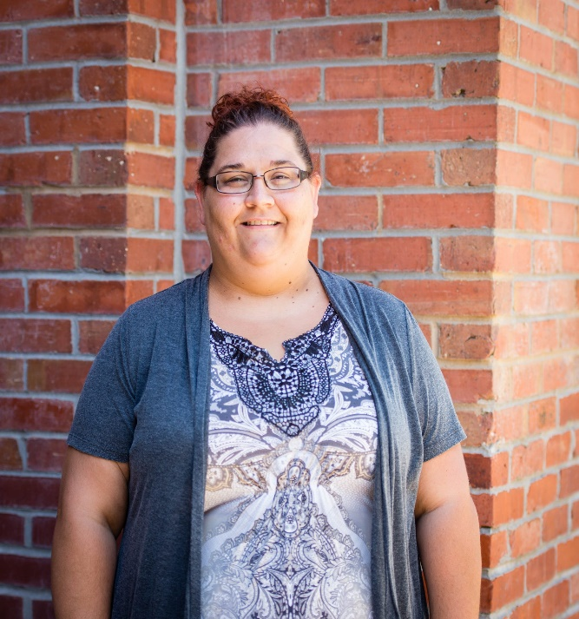
Licensed Student Counselors

Slide 23
College Response to Report of Sexual Harassment
Respond
Take action to end the discrimination
Remedy its effects (for an impacted individual and/or for the campus community)
Prevent its reoccurrence

Slide 24
Why Is This Necessary?
Our Obligation
Work together to provide an environment free from harassment/violence
Take steps to prevent harassment/violence from happening again
Remedy the effects of harassment and violence
It’s the law

Slide 25
College Response to Reports & Formal Complaints
Supportive Measures
No Contact Order
Changes to on campus living or working situations
Referral to a Licensed Student Counselor
Connect with other campus resources and services
Academic Accommodations
Accommodations, resources, and services are available to both the Complainant and the Respondent

Slide 26
Questions?
Are there other things you would like to see covered for Coaches?

